Slide 1

CS654: Digital Image Analysis
Lecture 28: Advanced topics in Image Segmentation
Image courtesy: IEEE, IJCV

Slide 2
Recap of Lecture 27
Clustering based Image segmentation
Mean Shift
Kernel density estimation
Application of Mean shift: Filtering, Clustering, Segmentation
Watershed segmentation

Slide 3
Outline of Lecture 28
Interactive image segmentation
Graph based segmentation
Graph-Cut
Grab-Cut

Slide 4
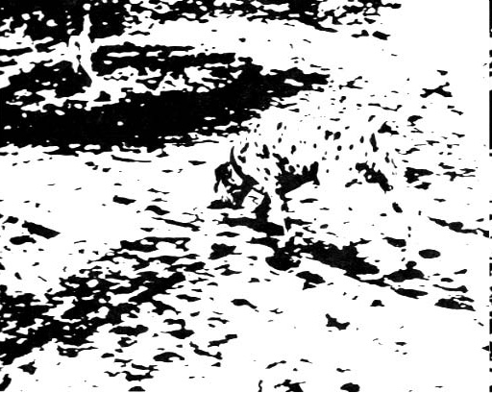
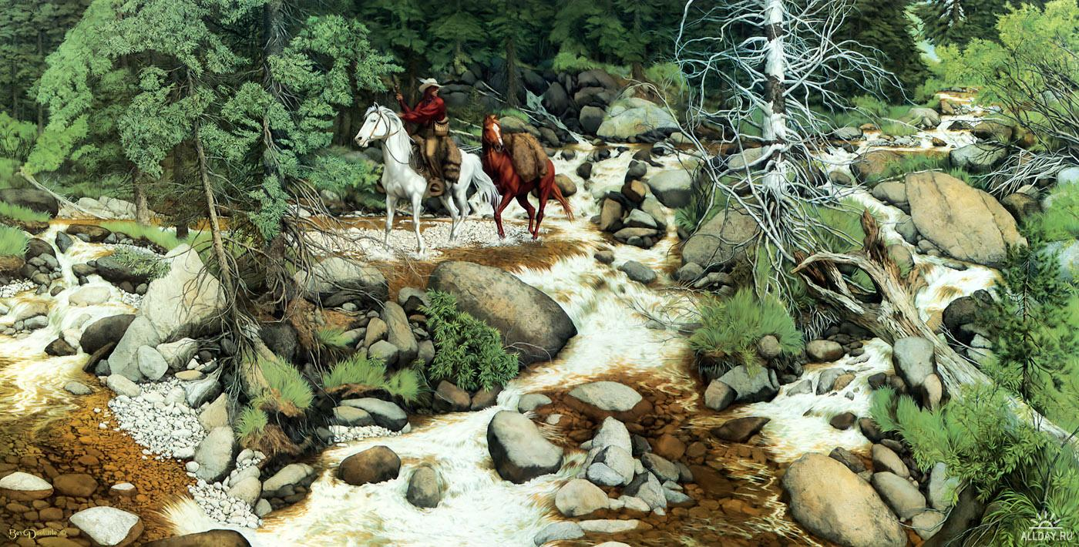
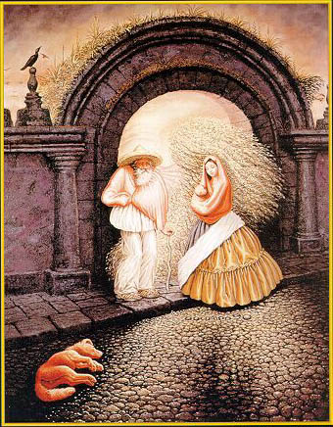

Automatic image segmentation is tough!!

Slide 5
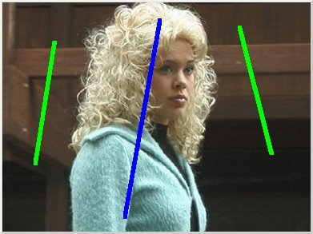

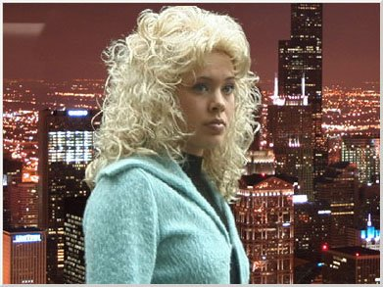
Interactive image segmentation
Original + cues
Binary segmentation
Foreground
Image cut-paste
Background

Slide 6
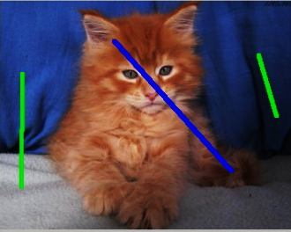
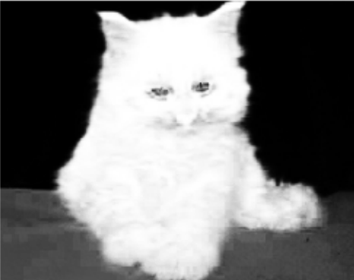
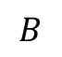
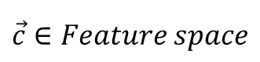
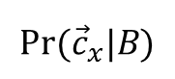
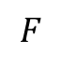
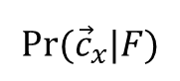
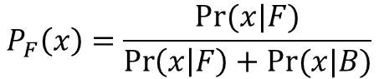
Interactive segmentation framework
$$Pr⁡({\vec{c}}_{x}|F)$$
$$F$$
$$B$$
$$Pr⁡({\vec{c}}_{x}|B)$$
$$\vec{c}∈Feature space$$
$$P_{F}\left(x\right)=\frac{Pr⁡(x|F)}{\operatorname{Pr}\left(x | F\right)+Pr⁡(x|B)}$$

Slide 7
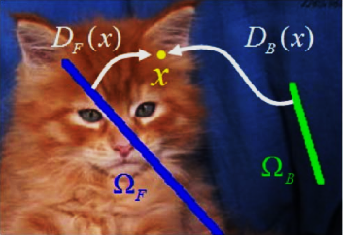
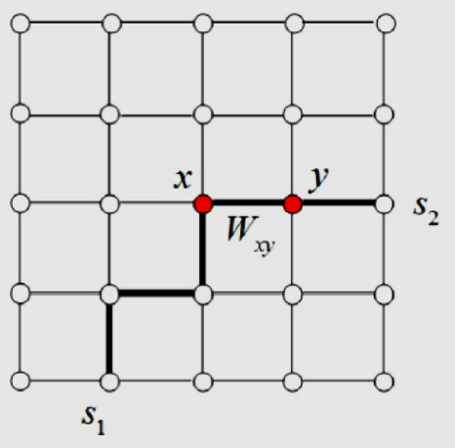
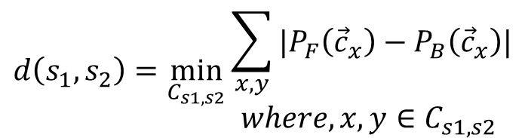
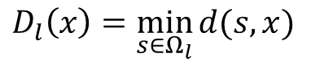
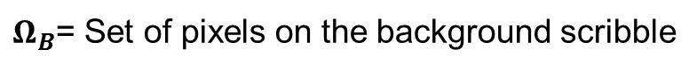
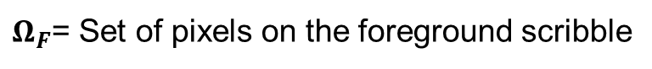
Use of distance criteria
$Ω_{F}$= Set of pixels on the foreground scribble
$Ω_{B}$= Set of pixels on the background scribble
$$D_{l}\left(x\right)=\min_{s∈Ω_{l}}{d(s,x)}$$
$$d\left(s_{1},s_{2}\right)=\min_{C_{s1,s2}}{\begin{aligned}\sum_{x,y}{|P_{F}\left({\vec{c}}_{x}\right)−P_{B}\left({\vec{c}}_{x}\right)|} \\ where, x,y∈C_{s1,s2} \end{aligned}}$$

Slide 8
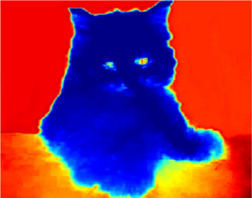
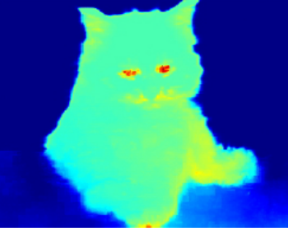
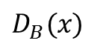
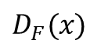
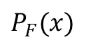
Illustration
Original + Scribbles
$P_{F}(x)$
$D_{F}(x)$
$D_{B}(x)$

Slide 9

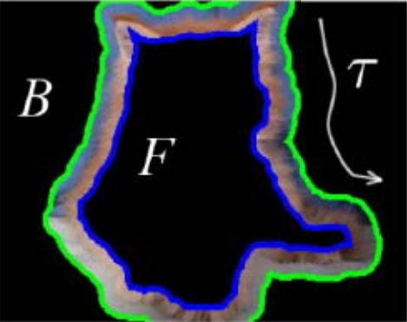

Interactive Segmentation: Refinement
Original image and scribbles
Automatically generated trimap
Obtained segmentation

Slide 10
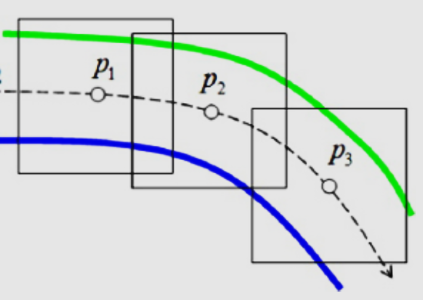
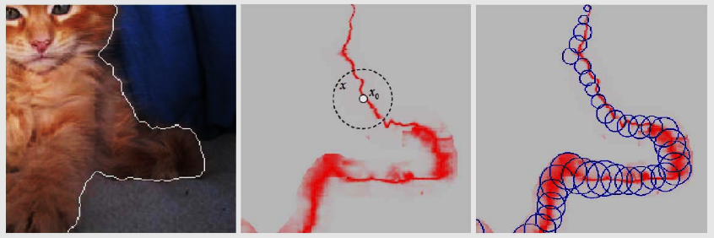
Interactive Segmentation: Local processing
Sliding window reﬁnement (fixed width band)
Sliding window reﬁnement (fixed width band)

Slide 11
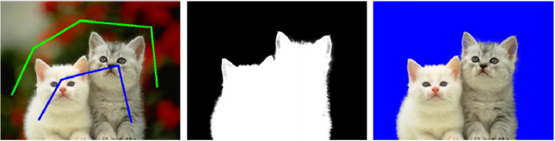
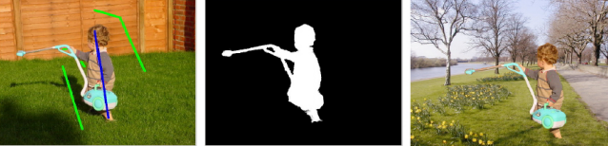
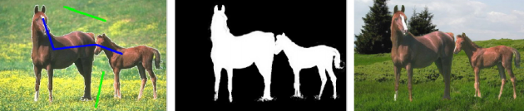
More examples
Binary
segmentation
Original + Scribbles
Image cut-paste

Slide 12
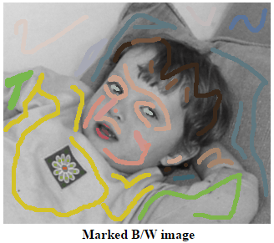
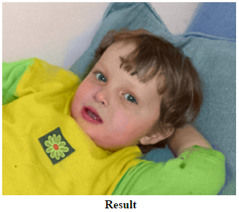
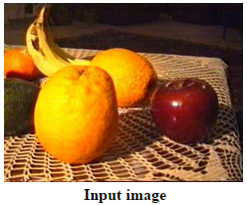
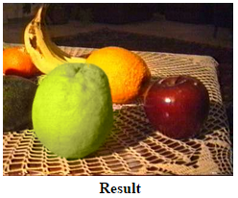
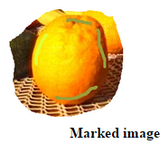
Application to other domain

Slide 13
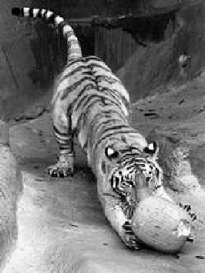
Images as graphs
i
w_{ij}
c
j
Fully-connected graph
node for every pixel
link between every pair of pixels, p,q
similarity w_{ij} for each link
Source: Seitz

Slide 14
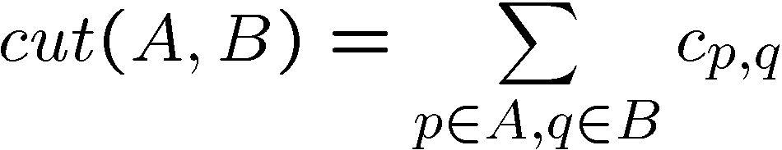
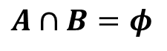

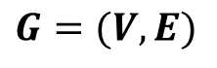
Cuts in a graph
$$G=(V,E)$$
$$A∪B=V$$
B
$$A∩B=φ$$
A
Link Cut
set of links whose removal makes a graph disconnected
cost of a cut:
One idea: Find minimum cut
gives you a segmentation
fast algorithms exist for doing this
Source: Seitz

Slide 15
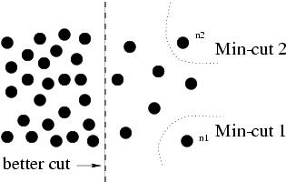
But min cut is not always the best cut...
Any cut that partitions out individual nodes on the right half will have smaller cut value
The cut that partitions the nodes into the left and right halves will have large cut value

Slide 16
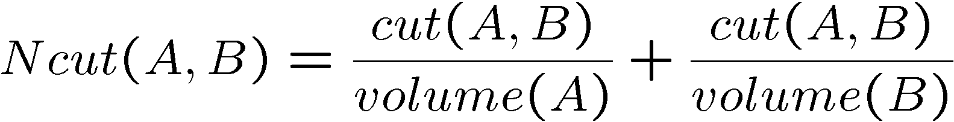
Cuts in a graph
Computes the cut cost as a fraction of the total edge connections to all the nodes in the graph
B
A
Normalized Cut (Shi and Malik)
a cut penalizes large segments
fix by normalizing for size of segments
volume(A) = sum of costs of all edges that touch A
Source: Seitz

Slide 17
Recursive normalized cuts
Given an image or image sequence, set up a weighted graph: G=(V, E)
Vertex for each pixel
Edge weight for nearby pairs of pixels
Solve for eigenvectors with the smallest Eigen values: (D − W)y = λDy
Use the eigenvector with the second smallest Eigen value to bipartition the graph
Note: this is an approximation
4. Recursively repartition the segmented parts if necessary
http://www.cs.berkeley.edu/~malik/papers/SM-ncut.pdf
Details:

Slide 18
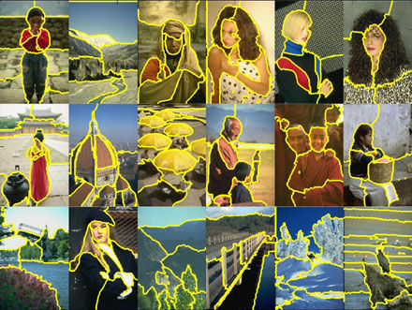
Normalized cuts results

Slide 19
Normalized cuts: Pro and con
Pros
Generic framework, can be used with many different features and affinity formulations
Provides regular segments
Cons
Need to chose number of segments
High storage requirement and time complexity
Bias towards partitioning into equal segments
Usage
Use for over segmentation when you want regular segments

Slide 20
Graph-Cut
A user imposes certain hard constraints for segmentation
These hard constraints provide clues on what the user intends to segment
Rest of the image is segmented automatically by computing a global optimum among all segmentations
The cost function is defined in terms of boundary and region properties of the segments
These properties can be viewed as soft constraints for segmentation.

Slide 21

Graph Cut (Boycov and Jolley)
Image
Foreground (source)
Background(sink)
Cut: separating source and sink; Energy: collection of edges
Min Cut: Global minimal enegry in polynomial time

Slide 22
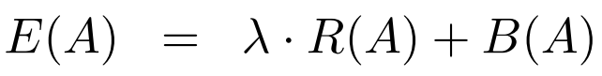
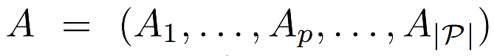
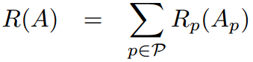
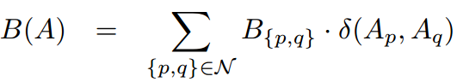
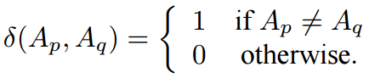
Optimization function formulation
Cost function:
Membership function:
Region property term:
Boundary property term:

Slide 23
Labeling as a graph problem
Each pixel = node
Add two nodes F & B
Labeling: link each pixel to either F or B
Desired result
F
F
B
F
F
B
F
B
B

Slide 24
Data term
Put one edge between each pixel and both F & G
Weight of edge = minus data term
Huge weight for hard constraints
Careful with sign (Non-negative)

Slide 25
Smoothness term
Add an edge between each neighbor pair
Weight = smoothness term

Slide 26
Min cut
Energy optimization equivalent to graph min cut
Cut: remove edges to disconnect F from B
Minimum: minimize sum of cut edge weight
cut

Slide 27
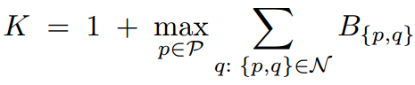
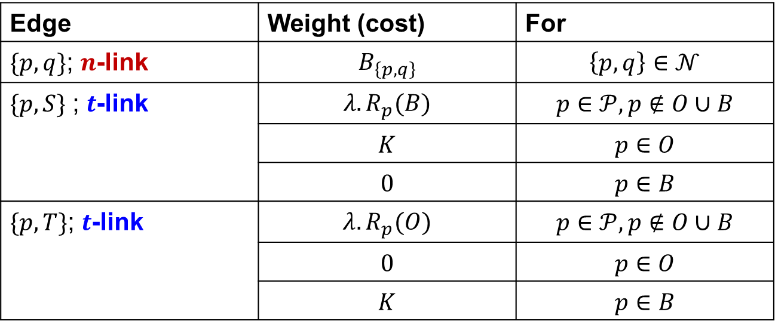
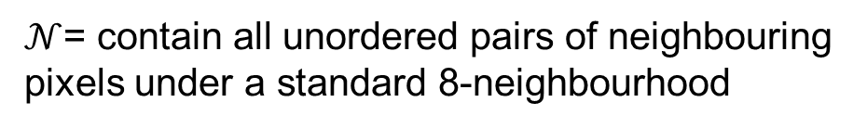

How to set weights
Edge | Weight (cost) | For
$\{p,q\}$; $n$-link | $$B_{\left\{p,q\right\}}$$ | $\left\{p,q\right\}∈𝒩$
$\{p,S\}$ ; $t$-link | $$λ.R_{p}(B)$$ | $$p∈𝒫, p∉O∪B$$
 | $$K$$ | $$p∈O$$
 | $$0$$ | $$p∈B$$
$\{p,T\}$; $t$-link | $$λ.R_{p}(O)$$ | $$p∈𝒫, p∉O∪B$$
 | $$0$$ | $$p∈O$$
 | $$K$$ | $$p∈B$$
$𝒫$= set of all pixels in the image
$𝒩$= contain all unordered pairs of neighbouring pixels under a standard 8-neighbourhood

Slide 28

Cut characteristics
Let $𝒞$ be a feasible cut on graph G, then
$𝒞$ severs exactly one $t$-link at each $p$
$\left\{p,q\right\}∈𝒞$ iff $p,q$ are $t$-linked to different terminals
If $p∈O,$then $\left\{p,T\right\}∈𝒞$
If $p∈B,$then $\left\{p,S\right\}∈𝒞$

Slide 29
Graph cuts segmentation
Define graph
usually 4-connected or 8-connected
Define unary potentials
Color histogram or mixture of Gaussians for background and foreground
Define pairwise potentials
Apply graph cuts
Return to 2, using current labels to compute foreground, background models

Slide 30
GrabCut: Rother et al.
Extension of GraphCut in three aspects
More powerful, iterative version of the optimisation
Simplify substantially the user interaction needed for a given quality of result
A robust algorithm for “border matting” has been developed to estimate simultaneously the alpha-matte around an object boundary and the colours of foreground pixels

Slide 31
Iterative image segmentation in GrabCut
Initialization
User initializes trimap
Background and foreground GMMs initialised
Iterative minimization
Assign GMM components to Pixel
Learn GMM parameters from data
Estimate segmentation
Repeat till convergence
Matting
User editing
Edit
Refinement

Slide 32

Illustration

Slide 33






Moderately straightforward examples
… GrabCut completes automatically
Notes:
Moderately straightforward examples- after the user input automnatically

Slide 34







Difficult Examples
Camouflage &
Low Contrast
Fine structure
No telepathy
Initial Rectangle
Initial Result
Notes:
You might wonder when does it fail. 4 cases. Low contrats – an edge not good visible

Slide 35
Further reading and resources
Normalized cuts and image segmentation (Shi and Malik)
http://www.cs.berkeley.edu/~malik/papers/SM-ncut.pdf
N-cut implementation
http://www.seas.upenn.edu/~timothee/software/ncut/ncut.html
Graph cuts
http://www.cs.cornell.edu/~rdz/graphcuts.html
Classic paper: What Energy Functions can be Minimized via Graph Cuts? (Kolmogorov and Zabih, ECCV '02/PAMI '04)

Slide 36




Quantitative Evaluation
The segmentation is evaluated by assessing its consistency with the ground truth
Image
Ground truth
Image
Ground truth

Slide 37



Example
Input image
Ground truth
Segmentation result
Performance evaluation

Slide 38



Quantitative measurement
True positive (TP)
True negative (TN)
False positive (FP)
False negative (FN)
$$Precision=\frac{TP}{TP+FP}$$
$$Recall=\frac{TP}{TP+FN}$$
$$Accuracy=\frac{TP+TN}{TP+TN+FP+FN}$$

Slide 39
Thank you
Next Lecture: Color Image Processing

